Slide 1




Slide 2

PROBLEM SOLVING- SKILLS & TECHNIQUES

Slide 3

TEST TIME ON: Plan & Organise
QR CODE:

Slide 4
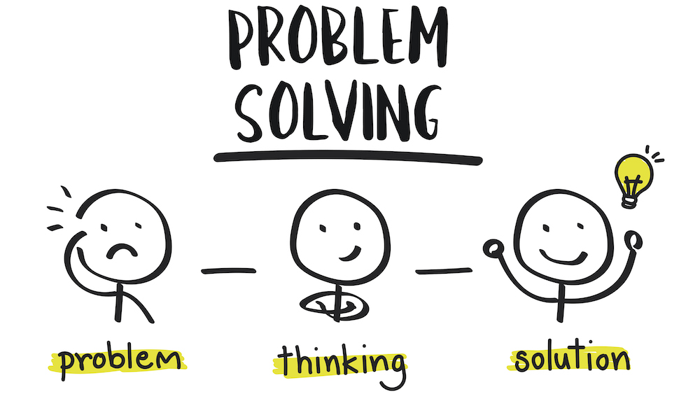
CONCEPTS
What is Problem-Solving Skill?
Notes:
Problem-solving skills help you determine the source of a problem and find an effective solution. Although problem-solving is often identified as its own separate skill, there are other related skills that contribute to this ability.
Some key problem-solving skills include:
Active listening
Analysis
Research
Creativity
Communication
Dependability
Decision making
Team-building
Problem-solving skills are important in every career at every level. As a result, effective problem solving may also require industry or job-specific technical skills. For example, a registered nurse will need active listening and communication skills when interacting with patients but will also need effective technical knowledge related to diseases and medications. In many cases, a nurse will need to know when to consult a doctor regarding a patient’s medical needs as part of the solution.

Slide 5
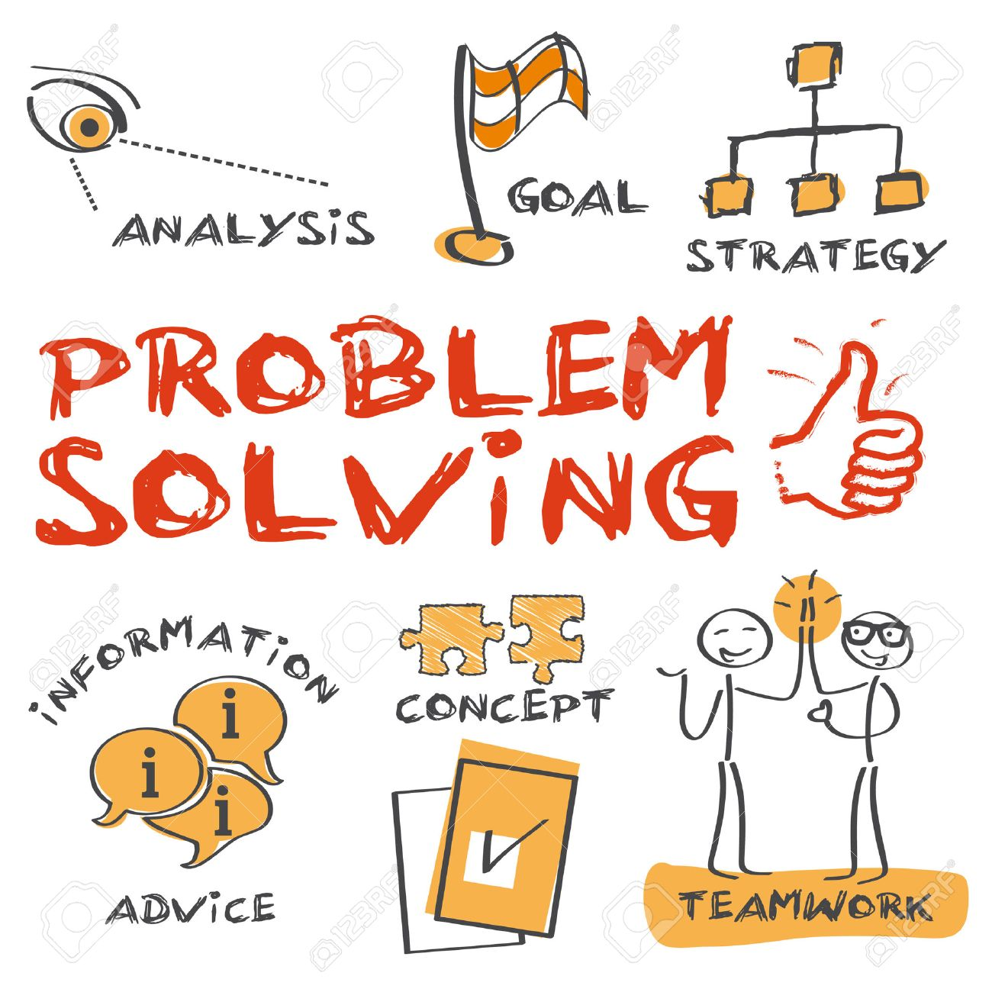
CONCEPTS
Steps in Problem-Solving

Slide 6

CONCEPTS
Define a Problem
Notes:
The first step to solving a problem is defining what the problem actually is – sounds simple, right? Well no. An effective problem solver will take the thoughts of everyone involved into account, but different people might have different ideas on what the root cause of the issue really is. It’s up to you to actively listen to everyone without bringing any of your own preconceived notions to the conversation. Learning to differentiate facts from opinion is an essential part of this process.
The same can be said of data. Depending on what the problem is, there will be varying amounts of information available that will help you work out what’s gone wrong. There should be at least some data involved in any problem, and it’s up to you to gather as much as possible and analyse it objectively.

Slide 7

CONCEPTS
List all the possible solutions
Notes:
Once you’ve identified what the real issue is, it’s time to think of solutions. Brainstorming as many solutions as possible will help you arrive at the best answer because you’ll be considering all potential options and scenarios. You should take everyone’s thoughts into account when you’re brainstorming these ideas, as well as all the insights you’ve gleaned from your data analysis. It also helps to seek input from others at this stage, as they may come up with solutions you haven’t thought of.
Depending on the type of problem, it can be useful to think of both short-term and long-term solutions, as some of your options may take a while to implement.

Slide 8

CONCEPTS
Evaluate the options
Notes:
Each option will have pros and cons, and it’s important you list all of these, as well as how each solution could impact key stakeholders. Once you’ve narrowed down your options to three or four, it’s often a good idea to go to other employees for feedback just in case you’ve missed something. You should also work out how each option ties in with the broader goals of the business.

Slide 9

CONCEPTS
Select an option
Notes:
Only now should you choose which solution you’re going to go with. What you decide should be whatever solves the problem most effectively while also taking the interests of everyone involved into account. There may be a way to merge two options together in order to satisfy more people.

Slide 10

CONCEPTS
Create an implementation plan
Notes:
At this point you might be thinking it’s time to sit back and relax – problem solved, right? There are actually two more steps involved if you want your problem solving method to be truly effective. The first is to create an implementation plan. After all, if you don’t carry out your solution effectively, you’re not really solving the problem at all.
Create an implementation plan on how you will put your solution into practice. One problem solving technique that many use here is to introduce a testing and feedback phase just to make sure the option you’ve selected really is the most viable. You’ll also want to include any changes to your solution that may occur in your implementation plan, as well as how you’ll monitor compliance and success.

Slide 11

CONCEPTS
Communicate your solution
Notes:
There’s one last step to consider as part of the problem solving methodology, and that’s communicating your solution. Without this crucial part of the process, how is anyone going to know what you’ve decided? Make sure you communicate your decision to all the people who might be impacted by it. Not everyone is going to be 100 per cent happy with it, so when you communicate you must give them context. Explain exactly why you’ve made that decision and how the pros mean it’s better than any of the other options you came up with.

Slide 12

CONCEPTS
Creative problem-solving techniques

Slide 13

CONCEPTS
Separate ideation from evaluation
Notes:
When you brainstorm creative ideas, have a separate time for writing it all down. Focus on generating lots of ideas. Don't prioritize or evaluate them until everything is captured.

Slide 14

CONCEPTS
Judging will shut it down
Notes:
Nothing stops the flow of creative ideas faster than judging them on the spot. Wait until the brainstorming is over before you evaluate.

Slide 15

CONCEPTS
Restate problems as questions.
Notes:
It's easier to entice a group into thinking of creative ideas when challenges are stated as open-ended questions.

Slide 16

CONCEPTS
Use "Yes and" to expand ideas.
Notes:
Here's one of the basic tenets of improv comedy. It's way too easy to shut down and negate ideas by using the word "but" (i.e. "But I think this is better..."). Avoid this at all costs. Instead, expand on what was previously introduced by saying "Yes, and..." to keep ideas flowing and evolving.

Slide 17
CONCEPTS
Give me an example of a problem you have faced in the past, either as part of a team or as an individual. How did you solve the problem?

Slide 18
CONCEPTS
Employers may base problem-solving questions around three main areas:
How you have approached situations in the past
How you would manage a problem that would arise as part of the job
How you handle problems throughout the application process

Slide 19
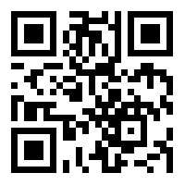
https://learn.codemithra.com

Slide 20




THANK YOU
+91 78150 95095
codemithra@ethnus.com
www.codemithra.com

